Slide 1
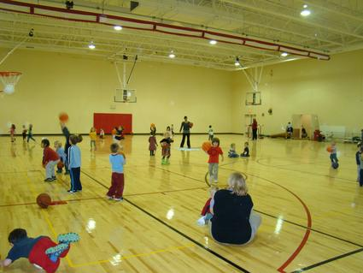
Innovative Recreation Programming 75th Annual Vermont Conference on Recreation October, 2018 Barbara Heller Heller and Heller Consulting

Slide 2
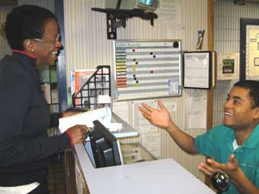
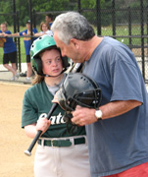
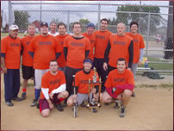
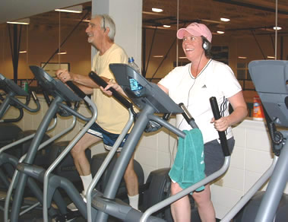
Session Outline
The Story of Recreation Programming
Development
Operational Excellence
Marketing
Pricing
Measuring
Trends and Innovation

Slide 3
Program Development
What is the process?

Slide 4
Recreation Program Development
Core competency of the organization
System approach
Organizational structure in alignment with community need
Needs assessment process and determining what programs are most important based on unmet need
Documenting processes to help new employees as well as standardizing processes for existing staff
Core program process

Slide 5
Recreation Program Development
Alignment of programs with changing demographics
Other providers in the marketplace
Trend/innovation process
Eradicate the status quo
Marketing strategies
Measuring success

Slide 6
Recreation Program Development: Core Program Definition
The program has been provided for a long period of time (or, more recent trend)
Offered three-four sessions per year
Wide demographic appeal
Includes 5% of more of recreation budget
Includes a tiered level of skill development
Requires full time staff to manage the program area
Has strong social value
High level of customer interface exists
High partnering capability

Slide 7
Program Outcomes Matrix
Program Impact
Repeat customers
Participant feedback
Supervisor observations
Financial Success
Revenue growth
Participant growth
Meeting cost recovery goals

Slide 8
Program Outcomes Matrix
Community Impact
Improve the community?
Collaborative/partners
Community reach (broad or narrow)
Leverage
Enhances PR
Feeds into other programs
Competition
Supply of other providers
Prices compared to others
Program differentiation

Slide 9
Recreation Programming Innovation
What are the cultural elements that need to be in place to support innovative recreation programming?

Slide 10
Operational Excellence
Ensuring high quality of programs

Slide 11
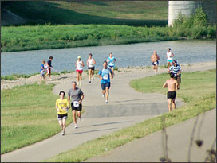
Recreation Program Operational Excellence
Service variation and reducing inconsistencies
Use of standards
Development of customer requirements
Determining future customer needs and requirements
Service encounters

Slide 12
Recreation Program Operational Excellence (contd.)
Service quality system
Audit system
Access reviews
Instructor reviews
Similar provider reviews
Duplication of service
Business plans for core programs
Annual review of programs; connection to marketing

Slide 13
Program Categories
Active Adult
Aquatics
Arts
Before/After school
Biking
Birthday party services
Childcare
Cooking
Dance
Day camps/School break camps
Early childhood
Environmental/Nature
Extreme sports
Fitness/wellness/nutrition
General Interest
Golf
Gymnastics/Tumbling
Historical programs
Homeschool
Ice Skating/Hockey
Language Arts
Lifelong Learning
Martial arts
Music
Outdoor adventure such as kayaking
Pets
Preschool
Running/Walking
Seniors
Special/Community Events
Sports
STEM
Summer Camp
Sustainability/Green programs
Teen programs
Tennis
Theatre/Acting
Therapeutic Recreation
Trips

Slide 14
Annual Review Process
Age segment
Lifecycle
Financial
Marketing strategies
Similar provider review
Underserved populations

Slide 15
Recreation Program Development: Lifecycle Analysis
Introduction stage
(New program; modest participation)
Growth stage
(Moderate, but consistent participation growth)
Mature/Saturation stage (Minimal to no participation growth, lots of competition)
Decline stage
(Declining participation)
Program Life Cycle Stages - Fitness
Introduction | Growth | Mature | Decline
Biggest Winner Fitness Challenge | Aerial Yoga
Mighty Kids Triathlon | Restorative Yoga | River Run 5K & 10K
Youth Fit | Group Fitness All Levels
Women's/Senior Weight Training | Group Fitness Active Older Adults
Small Grp Personal Training (Trx, boot camp) | Personal Training
5 | 5 | 1 | 0
45% | 45% | 9% | 0%

Slide 16
Repurchase Intent
L
O
Y
A
L
T
Y
(R
E
T
E
N
T
I
O
N)
100%
80%
60%
40%
20%
1 2 3 4 5
Very Dissatisfied Neither Satisfied Very
Dissatisfied Satisfied nor Satisfied
Dissatisfied
SATISFACTION MEASURE

Slide 17
Discussion Questions
What programs are currently doing well?
What programs are not doing well?
Discuss your program guide process (cycle time, how the guide is distributed, hard copies/online, frequency, advertising)?

Slide 18
Marketing Support
What is the state of your agency’s marketing?

Slide 19
Discussion
What are your greatest marketing successes?
What are your most significant marketing challenges?

Slide 20
Marketing
Overall marketing plan/business plans
Connection between marketing and operations
Image and brand
The most powerful marketing mechanism
Word of mouth and word of mouse
We rely so much on program brochures
Social media strategies
Trend/Innovation research

Slide 21
Pricing
Are you leaving money on the table?

Slide 22
Typical Approaches to Pricing
Let’s check around and see what everyone else is charging
Price to the 20% who cannot pay versus the 80% who can
Historical basis for fees and fee increases
Listening to special interest groups
High levels of entitled groups and services
Pricing and revenue generation is managed from a defensive position
Static, annual process
No cost of service or cost recovery goals in place for programs, facilities, and services
Lack of connection to the marketing of pricing

Slide 23
More Sophisticated Management Model for Pricing
The agency knows the true cost of managing a program, facility, or service based on cost centers and unit costs
Pricing Policy/revenue policy is in place that provides flexibility for staff to price services based on the market and the outcomes desired
Core and non core programs are identified
Pricing impacts are identified and quantified
Just in time financial results to provide data for pricing changes
Business plans are created for all core services, core facilities and services
Marketing/psychological impact of price
Solutions for customers, rather than policy

Slide 24
Pricing Template
Formalized process to ensure a standardized method to establishing price
What is the goal of establishing price?
Approval process
Revenue trends
Level of competition
Subsidy level goal
Elasticity of demand
Results of last increase
Three year history of increases
Comparative (others)
Revenue/participation trends

Slide 25
Evaluation Processes
Do you really know how you are doing?

Slide 26
Evaluation Processes
Technology support to provide actionable data
Financial support to provide just in time data
Audits
Customer satisfaction measurement
Program evaluations
Needs assessments
Development of a recreation program measurement system

Slide 27
Customer Satisfaction Measurement
Program evaluations
Surveys
Focus groups
Mystery shopping
Consumer advisory panels
Customer intercept surveys
On the spot surveys
Zero defect analysis

Slide 28
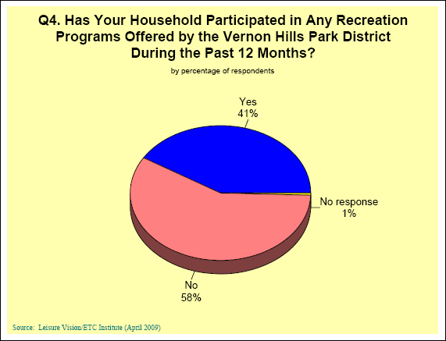
Participation in Recreation Programs

Slide 31
Barriers to Participation
Program times not convenient 22.5% 77.5%
Classes were full 1.2% 98.8%
Program not offered 9.0% 91.0%
Lack of quality instructors 2.2%
Use programs of other agencies 15.1%
I do not know what is offered 35.5%
Lack of quality programs 4.3%
Fees are too high 17.3%
Too far from residence 12.7%
Registration for programs is difficult 3.4%
Poor customer service by staff 0.9%
Lack of transportation 6.2%
Lack of right program equipment 2.5%
Too busy/not interested 40.7%

Slide 32
Examples of Performance Measures
% of cost recovery goals met
Facility utilization rates
Program success percentage (national average 80-85%)
Number of new programs
% of households who participate in programs
Overall program satisfaction
Customer satisfaction toward registration system
Customer satisfaction toward program guide
Customer referral and retention
Number of registrants
Gross and net revenues

Slide 33
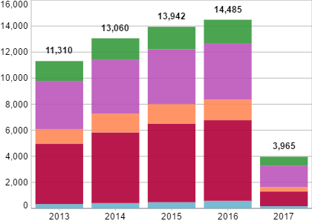
Examples of Performance Measures (contd.)
Revenue generated per full time staff
Internal customer satisfaction
Ratio of total revenue to total marketing dollars spent
% of programs in introduction and growth stage
Market penetration rates by age segment
Programs by age segments
Actual to budget financial performance

Slide 34
Observations from Nationwide Program Assessments
Slow to respond to changing ethnicities
Agency offerings are much more prevalent for youth than adults (75-25)
Difficulty with Active Adult / Teen market
Seniors are not 50, and there is a significant difference between the needs of 55 year olds and 75 year olds
Most frequent barriers to participation are inconvenient program times, don’t know what’s offered, and the cost
Evaluation systems are random, usually program evaluations and surveys
Part-time staff disconnect
Internal competition
No cost recovery goals or identification of true costs

Slide 35
PROGRAM TRENDS
Smart equipment
Cooking, local food
Bike sharing programs
Senior boot camps
Older adult memory and balance classes
Active adult masters’ participation
Functional fitness
Parkour
Yoga still popular, pilates not so much
Reduced participation in traditional youth sports
Travel team emphasis
Corporate wellness/health care reform
Programming in parks
Nature, green, sustainable practices
Outdoor/active recreation
Greatest program need: fitness/wellness

Slide 36
Questions?
Thanks so much for attending the session
For additional information, contact:
barbara@hellerheller.com
224.456.6934

