Slide 1
ParkRx: Prescription for Nature
Presented by: Vermont State Parks Rutland Recreation and Parks Vermont Farmers Food Center

Slide 2
Welcome and introductions
Craig Whipple, Director, Vermont State Parks
Maria Mayer, Parks Regional Manager, VT State Parks
Cindi Wight, Superintendent, Rutland Recreation & Parks
Heidi Lynch, Health Care Liaison, VT Farm and Food Center
Jaya Davis, Park Rx Health Coach, Rutland Recreation & Parks

Slide 3
Objectives:
Explore Vermont State Parks initiative to increase people’s awareness of connecting with nature and the benefits of outdoor physical activity.
Increase knowledge of the key elements involved in creating a ParkRx program.
Become familiar with the ParkRx implementation process and learn how to adapt our program to their community.

Slide 4
Outline:
Why is there a need for nature prescriptions?
Explore Vermont State Park initiative to connect healthcare providers, their patients, and state parks.
Key elements of a successful ParkRx program
Highlights of Rutland ParkRx program
Connection to ParkRx resources to create your own

Slide 5
The Need
Notes:
While Vermont is ranked as one of the healthiest states in the nation, these representative numbers are not seen in Rutland County, which currently suffers from high obesity rates across all ages, with 32% of the population considered obese (VT Department of Health 2015 Cancer Fact Sheet). Additionally, childhood obesity continues to plague the country and Rutland exemplifies this issue. “Of children age 2-5 participating in WIC in 2012 through the Rutland District Office, while only 13 percent are considered obese (BMI > 95th percentile for age and gender), this is the highest in the state. Many children who are overweight have high cholesterol and blood pressure levels, risk factors for heart disease.”(Vermont Department of Health 2012 Obesity in WIC Children Age 2-5).
There are several factors that contribute to physical inactivity in the community; including sedentary lifestyles and the correlation of low income with physical inactivity. In 2011, student grades 9-12 reported that on an average school day they used the computer for non-school activities, watched television or played video games for increasingly more time. In Rutland County, the percent of students engaging in these activities for 3 or more hours per day was 40% higher than the statewide rates. (Vermont Youth Risk Behavior Survey 2011, Vermont Department of Health, State and Rutland County). The CDC’ s Community Health Profile reports that 20.4% adults in Rutland County report no leisure time physical activity.
“Time and again, studies have demonstrated the “medicinal” impact of outdoor exercise. These studies emphasize the feeling of revitalization, along with decreases in tension, anger, and depression that come with physical activity in natural environments” (NRPA “Prescribing Parks for Better Health Success Stories”, p 3.) This, in turn, alleviates healthcare costs, particularly through its positive effects on chronic illnesses.
As of 2010, VT reported depression rates of 22%. People with lower incomes or with less education report depression more often than those with a higher socioeconomic status. “People with high rates of depression also often have higher rates of other health problems. Among adult Vermonters: 27% who are depressed report having fair or poor health, compared to 5% of those without depression.
54% who are depressed have a chronic disease (asthma, lung disease, cancer, diabetes,
obesity, or heart disease), compared to 35% of the those without depression.
Smoking prevalence among adults who also report depression is 31%, compared to
17% statewide.” (http://healthvermont.gov/pubs/healthdisparities/stress.pdf)
6 in 10 Vermont Adults are either obese or overweight. 25%of Vermonters are overweight
Overweight and obesity, defined as body mass indexes of 25 and 30 or higher, respectively, are known to increase the risk of conditions such as type 2 diabetes, some cancers (i.e. breast and colon), hypertension, coronary heart disease, stroke, and osteoarthritis.
Obesity is estimated to result in approximately $147 billion dollars in medical costs annually (2008 dollars) in the U.S.1 . CDC
Community health assessments every 3 years – one in 18
Mental and Physical Health
Child and Adult

Slide 6
Nature Rx
https://www.youtube.com/watch?v=7FS1xQsnI_I

Slide 7
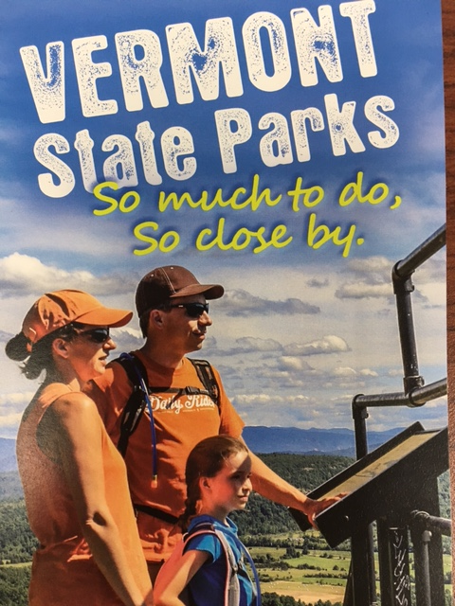
VT State Parks Prescription
Notes:
How VT State Parks Rx came to be
Started in 2014
Attempted to partner with insurance industry
Did a year of research
Currently partnering with Governor’s Council on Physical Fitness
Success and value of the program
Part of value is simply to reinforce message; media likes the concept
In order to be successful it needed to be unobtrusive to doctors; simple, quick
10000 issued in 2017 ; about 1000 turned in; while the numbers are not high we still consider it a success
Connections with other parts of presentation
Suggestion connect with physician already in the program (where is this list )?
Do we track what doctor prescribed the scripts that were turned in?

Slide 8
Advisory Team
Research other ParkRx models
Key elements for successful ParkRx
Funding
Existing Programs
Motivated Healthcare
Providers
Leverage partners
Outreach
Materials
Notes:
Research other Park Models
Can we provide them with a link to this info? Is it on our grant? Can we
Speak to other ParkRx folks
Successes and failures
How to structure incentives
Advisory Team
Should include health department
Can help set structure of program
Connections with funder
Connections with incentive providers
Good way to get message out
Funding
Federally qualified health care providers need to give back to community; many do so thru grants to keep their non profit status
Rutland Regional Medical Center uses the Bouse grant
How about Insurance providers?
Existing Programs that interface with providers
Riding coat tails
Healthcare Shares
Partners
State Parks
Other entities who have partnered with healthcare providers
Motivated Healthcare Providers
Might need to educate on need – we presented to them....
Borrowed connections from Food Share
Some heathcare providers may be motivated by QI programs in the medical field
May be based on what happens to patients after they leave hospital
With a little follow up in your you may be able to allow providers to recoup more costs
Outreach Materials
Maps
Info cards
Registration card
Rutland Rec had a graphic artist on retainer

Slide 9
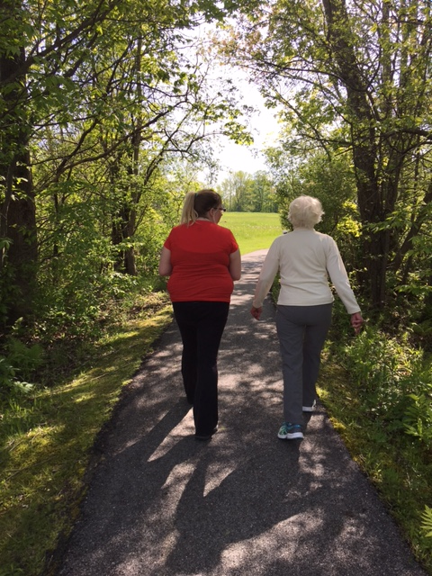
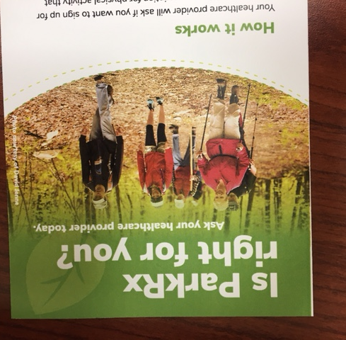
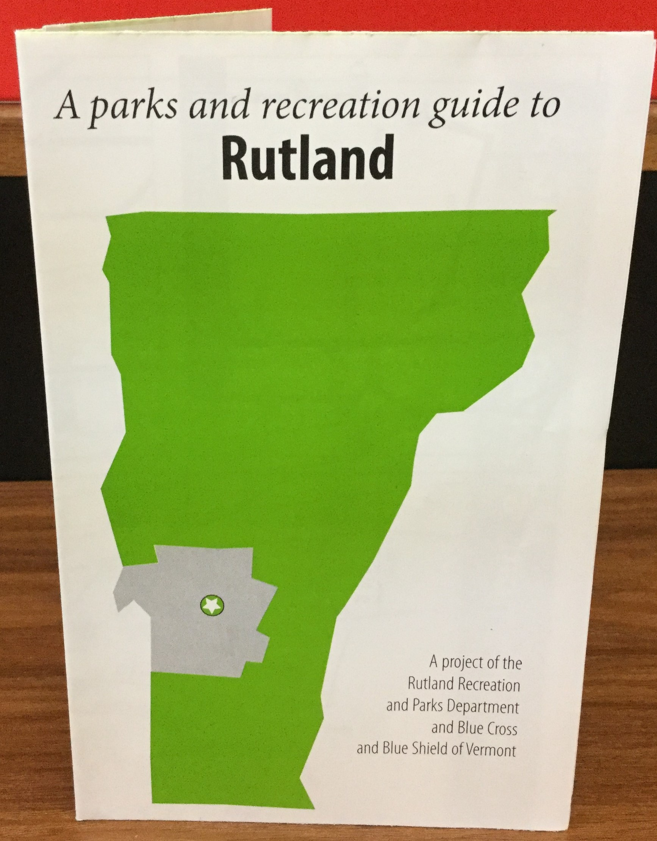
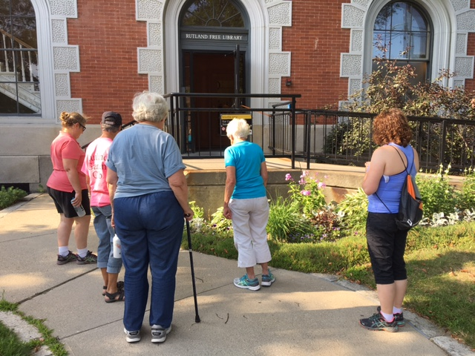
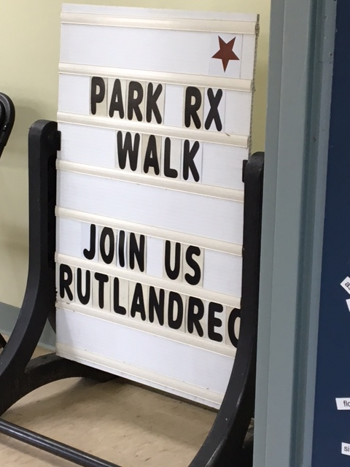
Rutland ParkRx
Notes:
How Rutland Parks Rx works:
Grant language says for both adults and kids
Target audience is adults with 150 min or less physical activity
12 week program
Health coach
Uses ‘Motivational Interviewing’ technique
Coach leads group walks
Map
Incentives; State Park pass, water bottle, Sensible Shoe coupon

Slide 10
Rutland ParkRx II
Notes:
What we’re finding what we’ve learned where we are heading
Have not had family or kid participation....
Stories
We were told incentives were important but few are using coupons
Maps need improvement – how did we say?
Know your ADA accessible type trails - very helpful
HIPPA
Only one self referral- how to handle these
Podiatrist with diabetes patients is a champion
Barriers
Mental health issues
Transportation to get to parks
Safety issues; some afraid to walk by themselves or be on bus by themselves
Economic issues – paying to get into state parks
Remember Green Mountain Passport for those over 62 free day admission to parks for 3$ at town clerk
$30 individual annual pass to Vermont State Parks
Meet people where they are
May not be in a park right off
Winter will be challenging
Do you send them to the mall or home depo?
We really are working just to get people comfortable leaving their homes in good weather; meet them where they are – small steps
Off couch and out of doors
Walking somewhere; even just around the block on sidewalk (not in a park but a step to getting there)
Do a group hike
End goal is getting into a green space
Program moving to Come Alive Outside
Philosophical discussion about orientating to being in parks and green spaces not just walking around the block
Other new ideas
Forest bathing as a talking point (since 1982 in Japan!)
Mental health providers

Slide 11
National Resources to get started:
National Park Rx: http://www.parkrx.org/
Healthy Parks, Healthy People: Bay Area: http://hphpbayarea.org/parkrx
ParkRx America (formally ParkRx DC): http://parkrxamerica.org/about.php
NCLI – great research links on kids needing to get green time
VTState park link
Green mountain passport
Fees page
Rx Coach Job Description: https://static1.squarespace.com/static/52e419c5e4b083a7aecc8ad6/t/5845801ad1758e37a136b702/1480949786919/Park+Rx+Health+Coach.pdf
Notes:
There’s a great link on Parkrx.org to a toolkit developed by the Bay Area Parks

Slide 12
Questions

